Slide 1
B1 VespAI monitor development, University of Exeter
B2: Design bait station for controlled Vv video capture
B3: Capture videos of Vv + Vc + other native insects [Portugal, UK, Jersey]
B4: Training data: Polygon annotation of Vv & Vc in subset of videos
Train AI to identify Vv, and Vc
B5: Image augmentation to supplement training data
Update AI to improve model fit
B6: Final algorithm architecture: AI code and analytics routines
B7: Optimise algorithm to enable VespAI to run on Raspberry Pi
B8: Update hardware design to combine VespAI with bait trap for prototype automated monitor
Options for different locations
Power/battery options
Connectivity options
B9: LED alert system
Market research:
Interested stakeholders
Demand
Configuration options
Price point
Field test prototype monitor
Plan for manufacture & roll out
B1 – B9 = background I.P.
Vv = Vespa velutina
Vc = Vespa crabro
Version 2 04/08/22

Slide 2
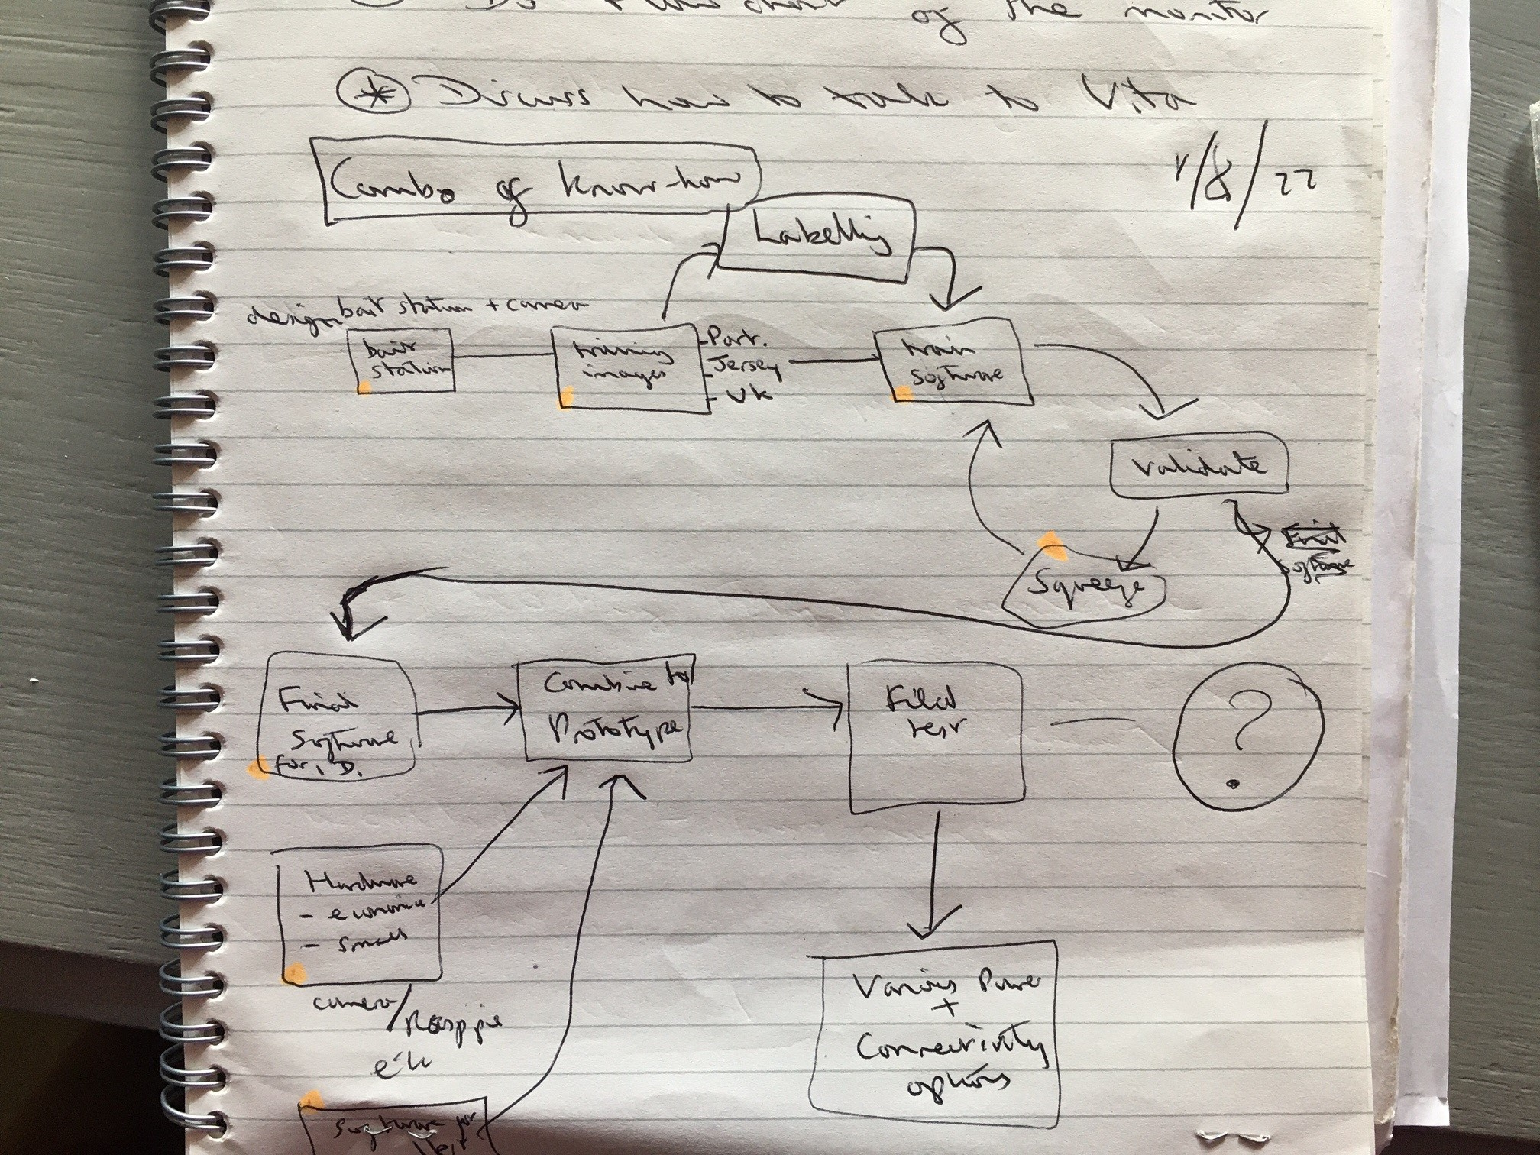
Version 1 01/08/22

